Slide 1
Central Limit Theorem
Geven Liu and Zefan Qian

Slide 2
Intro to CLT
The central limit theorem (CLT) establishes that, in many situations, when independent random variables are added, their properly normalized sum tends toward a normal distribution even if the original variables themselves are not normally distributed.

Slide 3
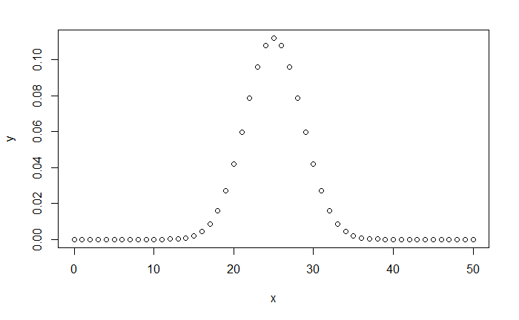
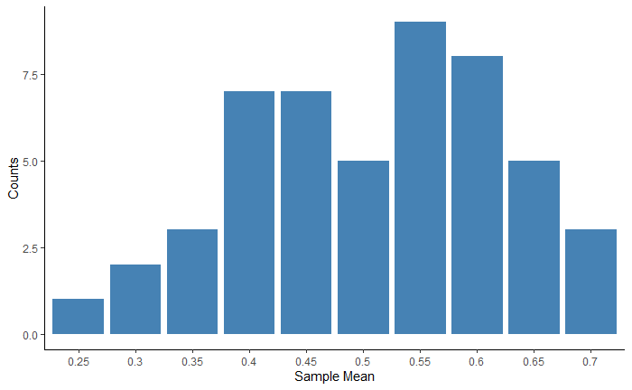
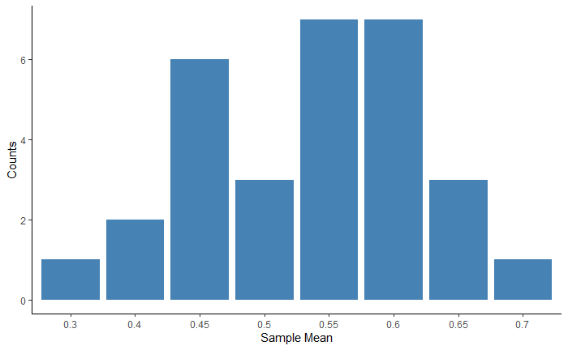
Intro to CLT

Slide 4
Intro to CLT

Slide 5
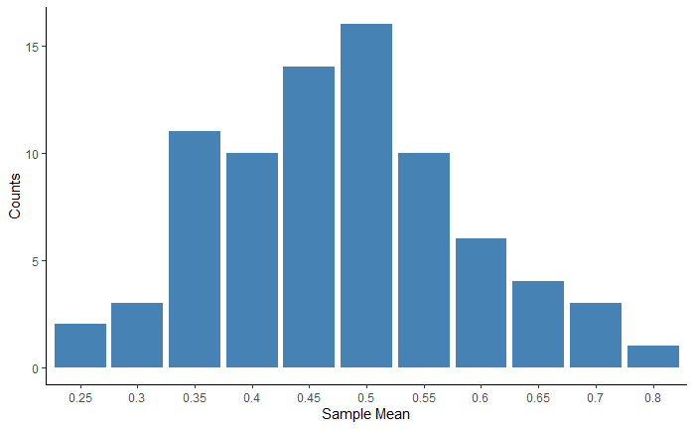
Intro to CLT

Slide 6
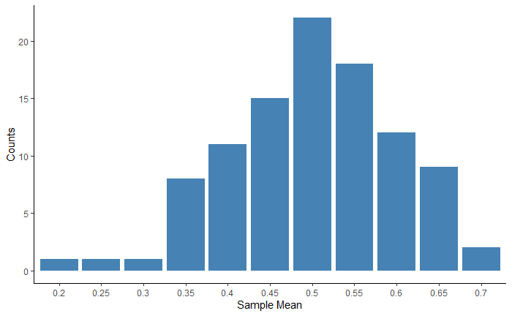
Intro to CLT

Slide 7
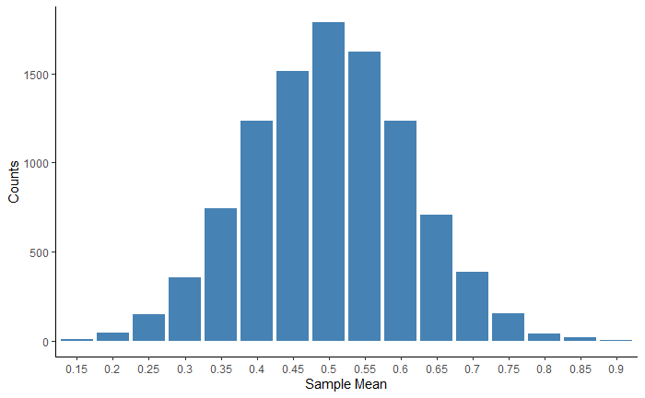
Intro to CLT

Slide 8
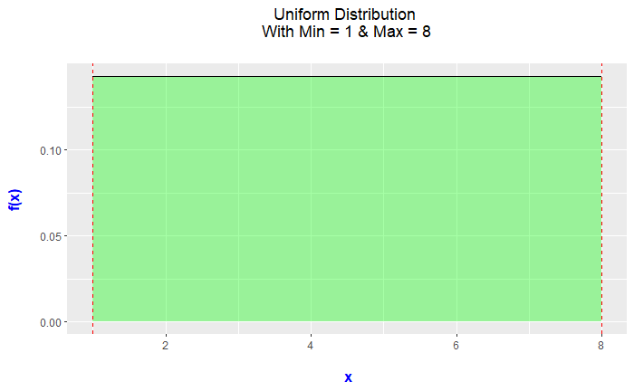
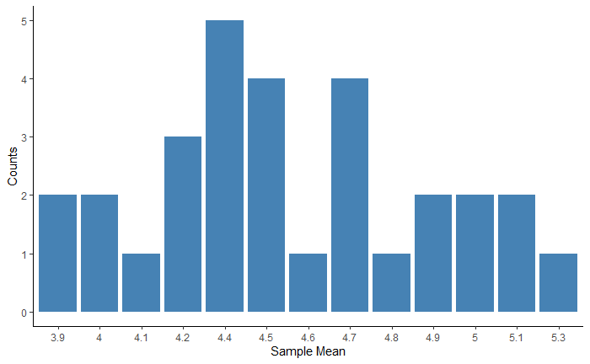
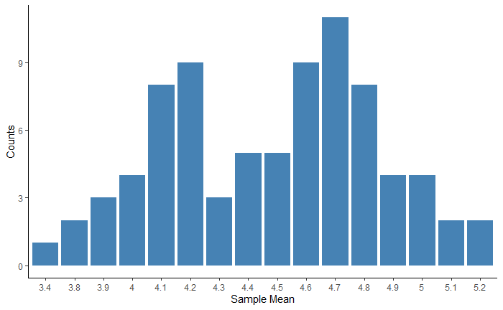
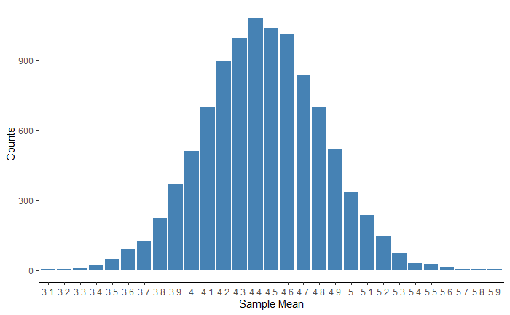
Intro to CLT
Symmetrical Distribution
50 means
80 means
100 means
10000 means

